Slide 1


Cameron Edenburn
Operating Systems 350-003
Spring 2026

Slide 2
Project Overview
Static VS Dynamic
Analyze memory behavior
Observe function addresses using WinDbg
WHY?:
I choose this project to better understand Malware!

Slide 3
Plan
Build
Build two versions of the same program
Static linking (epic.lib)
Dynamic linking (epicdll.dll)
Use
Use identical functions:
Input
Arithmetic
Output
Capture
Capture memory behavior before and after execution

Slide 4
Necessary Resources
Requirements:
Research linking concepts
Build working programs
Create model (flowchart)
Develop test cases
Collect runtime data
Present results

Slide 5
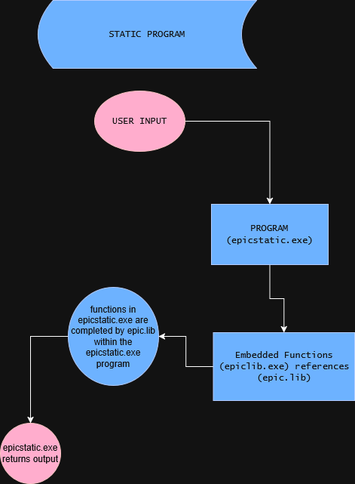
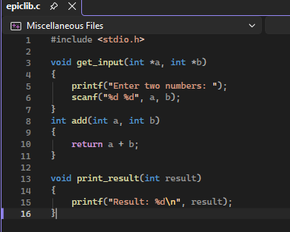
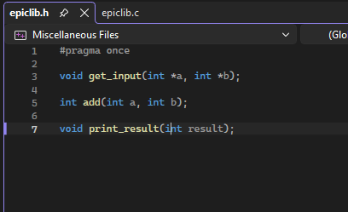
Model (STATIC)

Slide 6
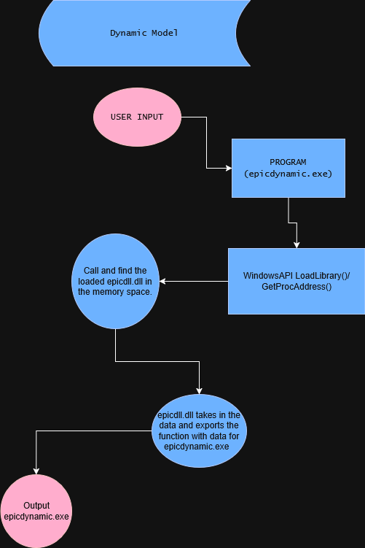
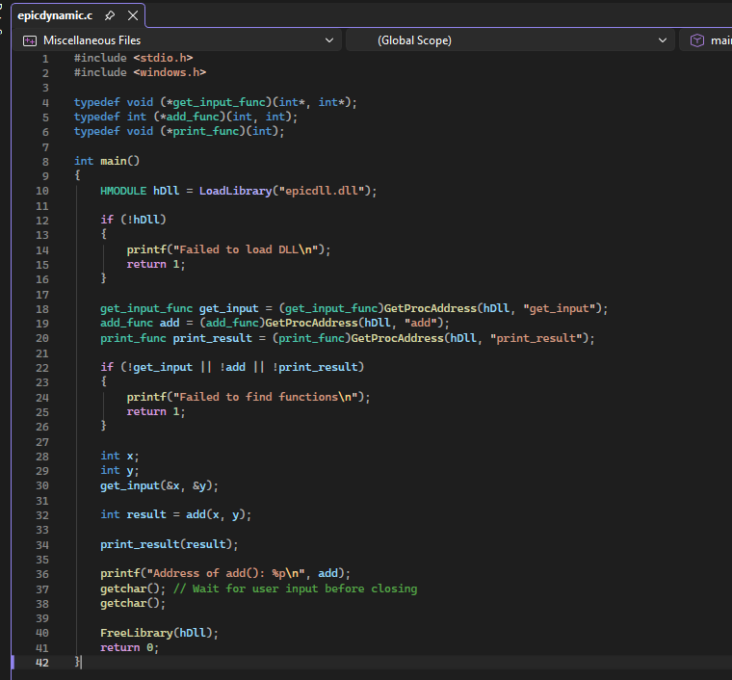
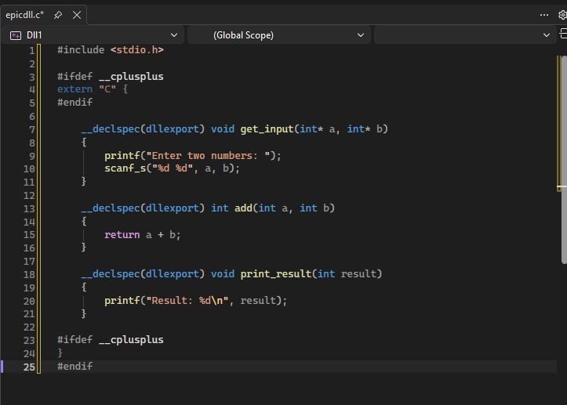
Model (Dynamic)

Slide 7
ID | Description | Expected Result | Pass/Fail | Notes | Trial
1 | Program Execution (Static & Dynamic) | Program accepts input and prints correct result | Pass | Input values and output (e.g., 3 + 4 = 7) | 1
2 | Arithmetic Correctness | add() returns correct sum | Pass | Test multiple inputs (5+5, 10+(-3), etc.) | 1–3
3 | Static Address Consistency | Address of add() remains the same across runs | Pass | Record address for 3–5 runs | 1–3
4 | Dynamic Address Variation | Address of add() may change across runs | Pass | Record address for 3–5 runs (variation or reuse) | 1–3
5 | DLL Load Verification (WinDbg) | epicdll.dll appears in memory | Pass | Screenshot lm showing DLL loaded | 1
6 | Static No-DLL Verification | No DLL present in static execution | Pass | lm shows only .exe, no epicdll.dll | 1
7 | Function Memory Location | add() address falls within correct memory range | Pass | Compare printed address with DLL range (dynamic) or EXE range (static) | 1
8 | Disassembly Verification | Function shows correct assembly instructions | Pass | u address shows add eax, edx (or equivalent) | 1
9 | Execution Flow (Dynamic) | Function may include jump instruction | Pass | Observe jmp before actual function in DLL | 1

Slide 8
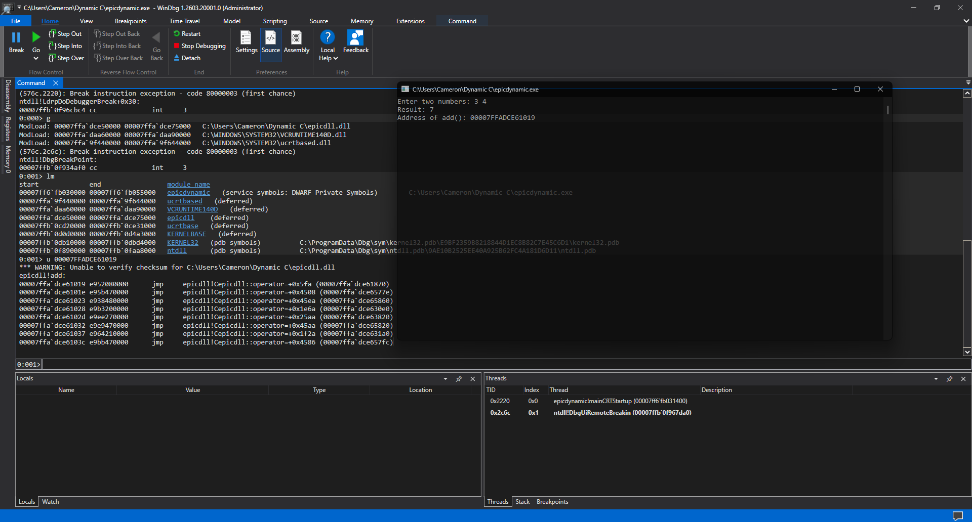
Execution

Slide 9
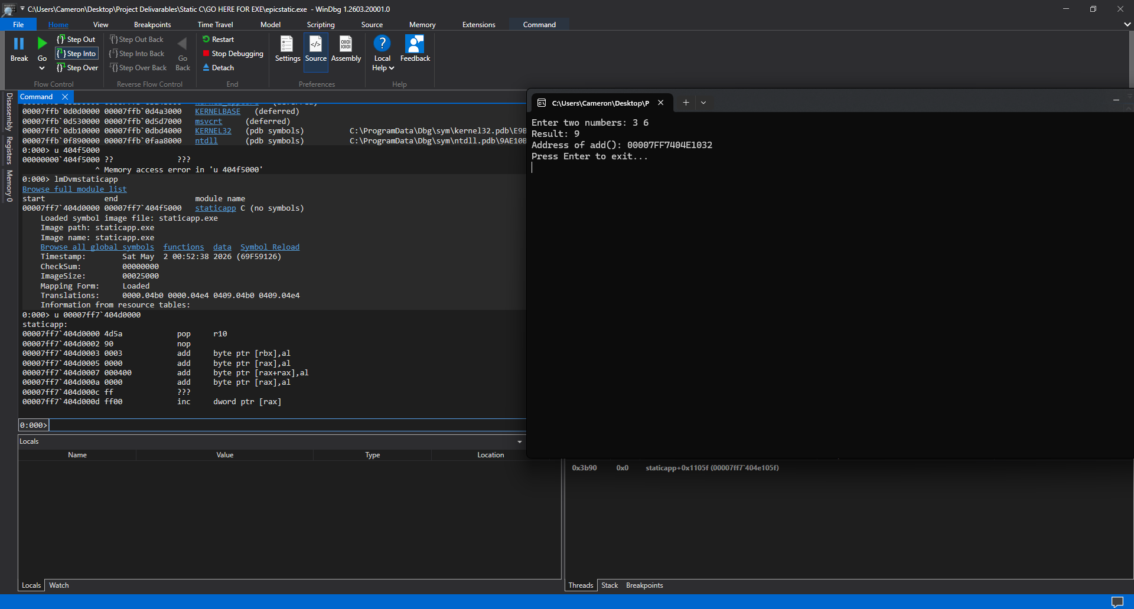

Slide 10
TEST CASES 3&4
EPICDYNAMIC.exe | EPICSTATIC.exe
Address of add(): 00007FFAF3CF1019
Address of add(): 00007FFAF2FD1019
Address of add(): 00007FFAF2FD1018
Address of add(): 00007FF686FA1032
Address of add(): 00007FF686FA1032
Address of add(): 00007FF686FA1032

Slide 11
Analyze/Conclusion
DYNAMIC & STATIC LINKING
MEMORY MANAGEMENT
ADVANTAGES
DISADVATAGES

